Slide 1
Donald Maffly
Scaling Test Automation using Metadata

Slide 2
Overview
Test Automation
Scale & Scalability
Metadata
Metadata example
Observations
Donald Maffly
Scaling Test Automation using Metadata

Slide 3
Test Automation
Agile projects require ‘continuous integration’ (CI)
CI requires test automation
Bad test automation => bad ‘Agile’
Bad test automation = tests that are expensive to maintain, tests that give many false fails, tests that takes too long to run
Donald Maffly
Scaling Test Automation using Metadata

Slide 4
Scale = Size
Donald Maffly
Scaling Test Automation using Metadata

Slide 5
Scale = Size
How big?
How long will it take?
How much will it cost?
How many lines of code?
How many users?
Amount of bandwidth?
Other capacity questions
Donald Maffly
Scaling Test Automation using Metadata

Slide 6
Scalable = Expandable
Growing a system over time
Increasing the capacity of a system
Increasing the number users
Increasing the bankwidth
Increasing the number of cooperating entities
etc
Donald Maffly
Scaling Test Automation using Metadata

Slide 7
Challenges to Determining Scale
Biases
State of mind
Lack of experience
Politics
Blind spots
Conflicting priorities
Donald Maffly
Scaling Test Automation using Metadata

Slide 8
Scale: Sizing a Project
Donald Maffly
Scaling Test Automation using Metadata

Slide 9
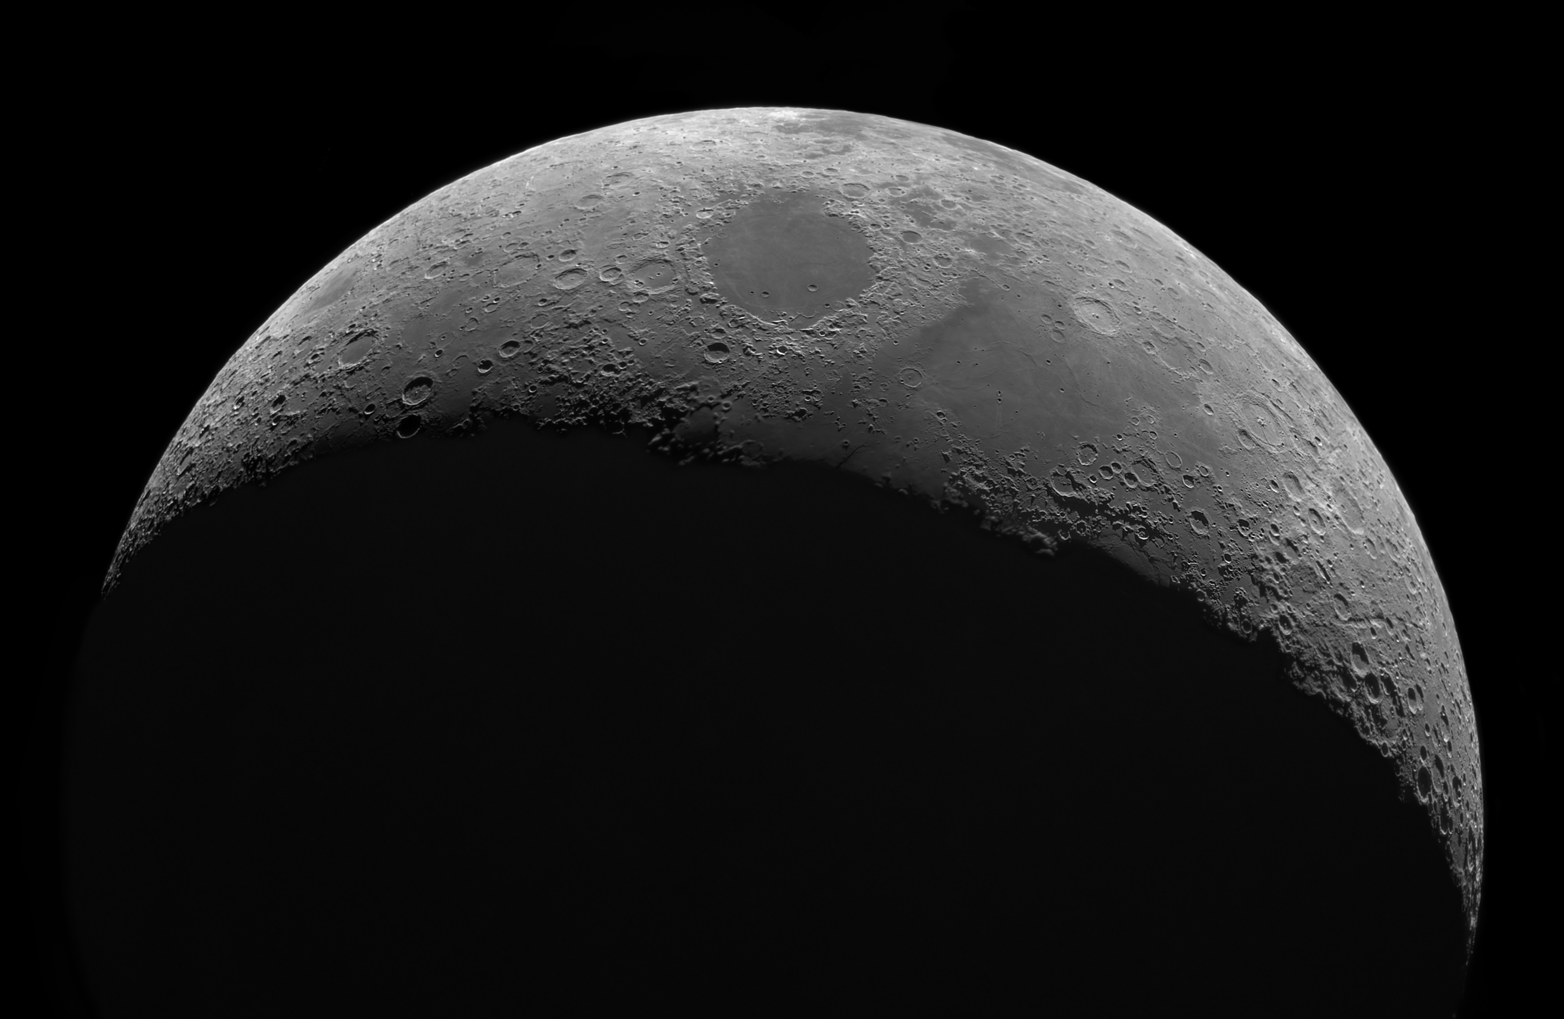
Scale: The Apollo Project
Project on time!
Planned: ‘end of decade’
Actual: July 1969
Project over-budget
Planned: $7 billion
Actual: $25 billion
Donald Maffly
Scaling Test Automation using Metadata

Slide 10
Scale: a Frog
Donald Maffly
Scaling Test Automation using Metadata

Slide 11
Scale: Butterflies
Donald Maffly
Scaling Test Automation using Metadata

Slide 12
Scale and Scalability
Scale=size
Scalability=expandability
If you can’t determine the size/scale of something, then you will struggle with scaling it (up)
Donald Maffly
Scaling Test Automation using Metadata

Slide 13
Sizing a Universe
Donald Maffly
Scaling Test Automation using Metadata

Slide 14
A Universe of Galaxies
Donald Maffly
Scaling Test Automation using Metadata

Slide 15
How to create tests that DO NOT scale well
Cut and pasting test code to create new tests
Scaling not factored into test architecture
Ignoring time it takes to run a test
Unintended side effects:
Combinatoric maintenance explosion
Test execution clogging up CI pipelines
Donald Maffly
Scaling Test Automation using Metadata

Slide 16
Creating Tests that Scale Well
Using code reuse strategies (templates, generics, metadata)
Designing for scalability (modules/libraries that support scalability)
Designing for test time efficiency (parallelism, test groupings)
Donald Maffly
Scaling Test Automation using Metadata

Slide 17
Metadata: What is ‘Meta’?
Metajoke
Metaword
Metacognition
Metaclass
Metadata
Donald Maffly
Scaling Test Automation using Metadata

Slide 18
Metadata: System Under Test
Large regional bank in Pacific NW
Several hundred cooperating financial institutions
Data warehouse serving business intelligence (BI)
End users (~50 ?) decision makers inside the bank
$37 billion in loans
$45 billion in deposits
Donald Maffly
Scaling Test Automation using Metadata

Slide 19
Metadata : Example
IncomingData
Packages
TestResults
TestCases
IncomingDataID
PackageID
TestResultsID
TestCaseID
Name
Name
TestCaseID
TestCaseName
Source
Location
PackageID
TestCategoryID
Location
Ordinal
PackageResultsID
Description
Frequency
StartTime
ExpectedSize
EndTime
SizeRange
RunInfo
TestCategories
PackageID
TestCategoryID
PackageResults
PackageResultsID
CategoryName
SUT metadata
Description
PackageID
TestValidations
SuccessYN
TestValidationID
Test metadata
StartTime
PackageID
EndTime
RunInfo
SqlValidationSproc
Donald Maffly
Scaling Test Automation using Metadata

Slide 20
Metadata : a Team Hub
Business Analysts
Development
Metadata
Quality
Assurance
Operations
Stakeholders/
Customers/
Surrogates
Donald Maffly
Scaling Test Automation using Metadata

Slide 21
Metadata : Coding Test Automation
Read metadata into test automation program using ORM (object-oriented relational management tool)
Metadata tables map nicely into object-oriented classes
Metadata tables map nicely into generics, templates
Donald Maffly
Scaling Test Automation using Metadata

Slide 22
Observations
Lines of test code reduced by 10x
Fewer false fails in test runs
Tests run faster (in parallel)
Creating targeted test suites
Associations from Test Results to SUT functionality
Metadata repository visible to everyone
Donald Maffly
Scaling Test Automation using Metadata

