Slide 1
Building a Culture of Accessibility
From Awareness to Action
-Younus Poonawala
-Dhara Pattani
#PNSQC2023 #A11YTESTERS BUIDING A CULTURE OF ACCESSIBILITY
1

Slide 2
Thank you PNSQC
#PNSQC2023 #A11YTESTERS BUIDING A CULTURE OF ACCESSIBILITY
2

Slide 3
Request
You have a choice!
From the next screen choose 1 Path and follow the instructions for only 2 minutes
#PNSQC2023 #A11YTESTERS BUIDING A CULTURE OF ACCESSIBILITY
3

Slide 4
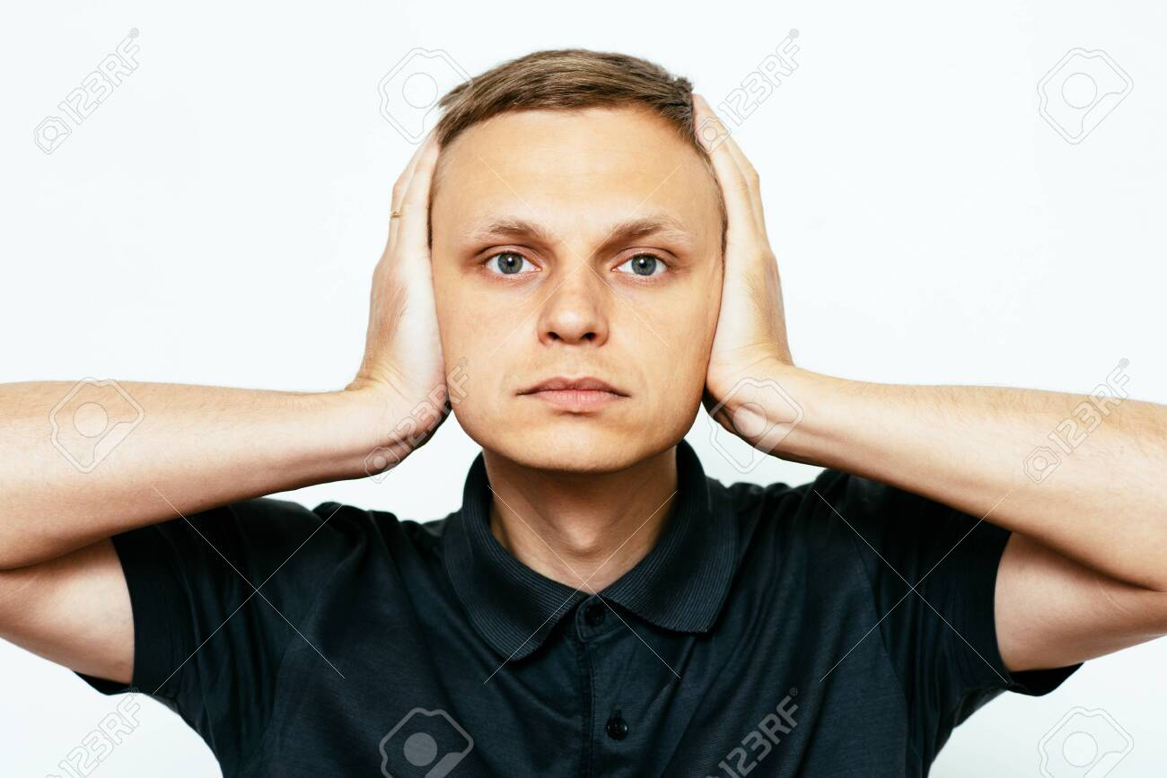
Path 1
Path 2
Close Your Eyes and Just Listen
Mute the speakers and just watch how the slides go
#PNSQC2023 #A11YTESTERS BUIDING A CULTURE OF ACCESSIBILITY
4

Slide 5
What is Accessibility
The inclusive practice of removing barriers that prevent interaction with, or access to, websites by people with disabilities.
Source: wikipedia
#PNSQC2023 #A11YTESTERS BUIDING A CULTURE OF ACCESSIBILITY
5

Slide 6
Key Takeaways
1 out of 5 individuals using the products you build are disabled in one of the many ways
Awareness is one thing, Action for Accessibility is another
A roadmap for your team for including and embracing accessible products
Source: wikipedia
#PNSQC2023 #A11YTESTERS BUIDING A CULTURE OF ACCESSIBILITY
6

Slide 7
Testers Now Let's Open Our Eyes and Ears
#PNSQC2023 #A11YTESTERS BUIDING A CULTURE OF ACCESSIBILITY
7

Slide 8
We are
15 Years of focused mixed bag experience
Evangelist for accessibility
Consults, Audits and Harbinger for Accessibility
Younus P
#PNSQC2023 #A11YTESTERS BUIDING A CULTURE OF ACCESSIBILITY
8

Slide 9
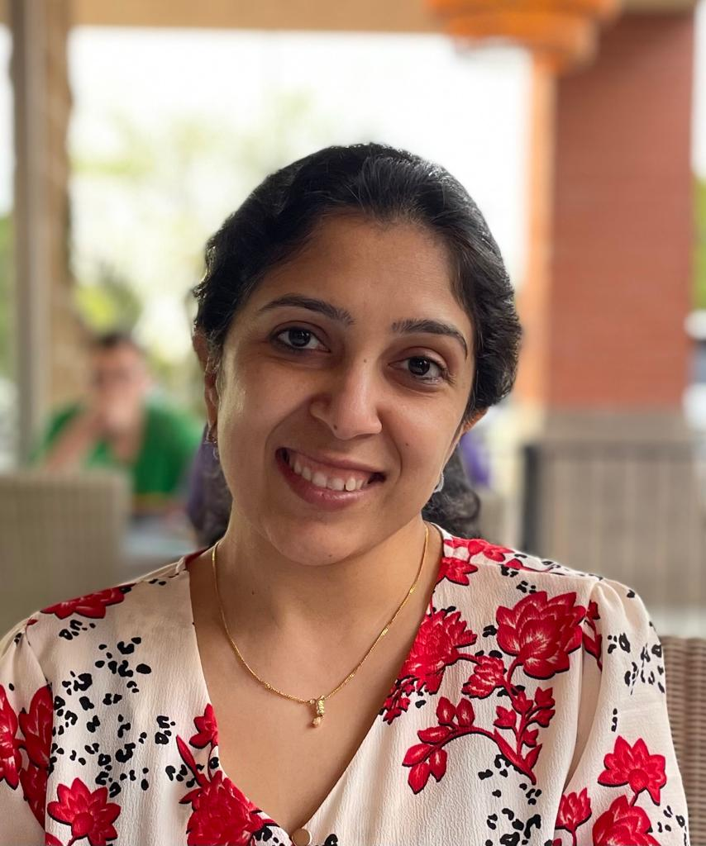
We are
7 Years of focused QA / Accessibility testing
Evangelist for accessibility
Consults, Audits and Harbinger for Accessibility
Dhara P
#PNSQC2023 #A11YTESTERS BUIDING A CULTURE OF ACCESSIBILITY

Slide 10
Why Accessibility Matters?
Empowering Individuals
Enhancing User Experience
Expanding Market Reach
Meeting Legal Requirements
Fostering Innovation
#PNSQC2023 #A11YTESTERS BUIDING A CULTURE OF ACCESSIBILITY
10

Slide 11
Empowering Individuals
Accessible digital content provides independence.
It allows people with disabilities to participate in education and employment.
Access to information fosters personal growth and self-confidence.
#PNSQC2023 #A11YTESTERS BUIDING A CULTURE OF ACCESSIBILITY
11

Slide 12
2. Enhancing User Experience
Accessibility benefits all users, not just those with disabilities.
Clear navigation, structured content, and customization enhance user satisfaction
Positive user experiences lead to customer loyalty and satisfaction
#PNSQC2023 #A11YTESTERS BUIDING A CULTURE OF ACCESSIBILITY
12

Slide 13
3. Meeting Legal Requirements
Accessibility is a legal obligation in many countries.
Compliance with accessibility standards reduces legal risks.
Avoiding legal issues preserves your organization's reputation.
#PNSQC2023 #A11YTESTERS BUIDING A CULTURE OF ACCESSIBILITY
13

Slide 14
4. Expanding Market Reach and Fostering Innovation
Accessible products tap diverse markets
Prioritizing accessibility expands the user base and fuels innovation
Encourages solutions that benefits society as a whole
#PNSQC2023 #A11YTESTERS BUIDING A CULTURE OF ACCESSIBILITY
14

Slide 15
5. Embracing Accessibility as a Core Principle
Prioritizing for an inclusive digital world
Empowers individuals, enhances user experiences, and drives innovation
Let us work for accessible technology and an equitable and inclusive society
#PNSQC2023 #A11YTESTERS BUIDING A CULTURE OF ACCESSIBILITY
15

Slide 16
Common Misconceptions about Accessibility
Accessibility is only for people with disabilities
Accessibility is expensive
Accessibility is difficult to do
We don’t need to conform to any Accessibility Standards
#PNSQC2023 #A11YTESTERS BUIDING A CULTURE OF ACCESSIBILITY
16

Slide 17
Accessibility is only for people with disabilities
Truth: Accessibility benefits all users, regardless of their abilities.
Examples: Keyboard navigation, font resizing, dark modes, high contrast colors, voice, and touch controls benefit a wide range of users.
#PNSQC2023 #A11YTESTERS BUIDING A CULTURE OF ACCESSIBILITY
17

Slide 18
2. Accessibility is expensive
Truth: Accessibility can be achieved cost-effectively.
Strategies: Use free tools for text alternatives, make small website/application changes, integrate accessibility into workflow.
Consequences: Ignoring accessibility can lead to legal action and reputational damage.
#PNSQC2023 #A11YTESTERS BUIDING A CULTURE OF ACCESSIBILITY
18

Slide 19
3. Accessibility is difficult to do
Truth: Resources are available to help make products and services accessible.
Resources: W3C accessibility guidelines, accessibility consulting firms, growing community of developers skilled in accessibility.
#PNSQC2023 #A11YTESTERS BUIDING A CULTURE OF ACCESSIBILITY
19

Slide 20
4. We do not need to conform to any Accessibility Standards
Truth: Conforming to standards is essential to ensure equal access and mitigate legal risks.
Legal Framework: Title III of the Americans with Disabilities Act (ADA) applies to many websites and apps.
Importance: Conforming to WCAG guidelines (e.g., WCAG 2.2) is vital to avoid exclusion of users and seize business opportunities.
#PNSQC2023 #A11YTESTERS BUIDING A CULTURE OF ACCESSIBILITY
20

Slide 21
Core Accessibility principles
Perceivable
Operable
Understandable
Robust
#PNSQC2023 #A11YTESTERS BUIDING A CULTURE OF ACCESSIBILITY
21

Slide 22
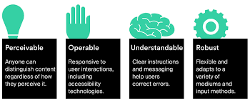
Core Accessibility principles
#PNSQC2023 #A11YTESTERS BUIDING A CULTURE OF ACCESSIBILITY
22

Slide 23
Perceivable
Information and user interface components must be presented to users ways they can perceive
Examples:
Provide text alternatives for non-text content, such as images and videos.
Use sufficient color contrast between text and background.
Provide captions and transcripts for multimedia content.
#PNSQC2023 #A11YTESTERS BUIDING A CULTURE OF ACCESSIBILITY
23

Slide 24
Operable
User interface components and navigation must be operable
Examples:
Make sure all functionality is available from a keyboard.
Provide enough time for users to read and use content.
Avoid using flashing content or other features that could cause seizures.
#PNSQC2023 #A11YTESTERS BUIDING A CULTURE OF ACCESSIBILITY
24

Slide 25
Understandable
Information and the operation of user interface must be understandable.
Examples:
Use clear and concise language.
Avoid using jargon and technical terms.
Provide context and instructions for all functionality.
#PNSQC2023 #A11YTESTERS BUIDING A CULTURE OF ACCESSIBILITY
25

Slide 26
Robust
Content must be robust enough that it can be interpreted reliably by a wide variety of user agents, including assistive technologies.
Examples:
Use valid HTML and CSS.
Avoid using proprietary technologies.
Provide alternative ways for users to interact with content if JavaScript is disabled.
#PNSQC2023 #A11YTESTERS BUIDING A CULTURE OF ACCESSIBILITY
26

Slide 27
What if we think about integrating accessibility into our daily routines rather than just adding it as an afterthought?
Let’s see how to do it
#PNSQC2023 #A11YTESTERS BUIDING A CULTURE OF ACCESSIBILITY
27

Slide 28
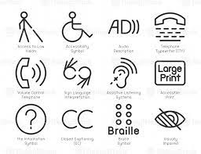
Awareness : Build a Mindset
#PNSQC2023 #A11YTESTERS BUIDING A CULTURE OF ACCESSIBILITY
28

Slide 29
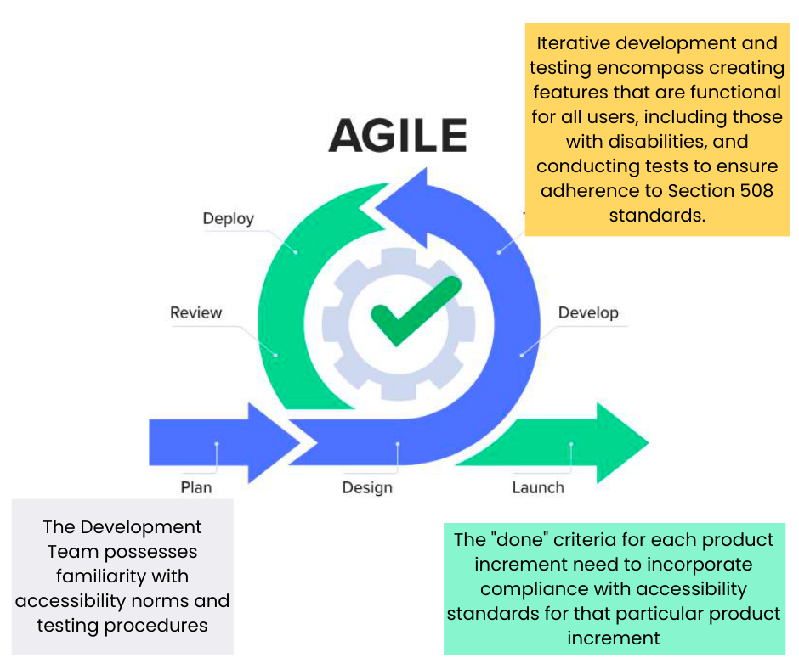
Accessibility in Agile
#PNSQC2023 #A11YTESTERS BUIDING A CULTURE OF ACCESSIBILITY
29

Slide 30
Daily Standup Meetings (Daily Scrum)
Accessibility Updates
Team members share accessibility-related progress
Discuss resolving issues, assistive technology, and accessible design
Accessibility Blockers
Highlight accessibility obstacles encountered
Promptly address these challenges
Why it Matters
Including accessibility in daily standups ensures that accessibility considerations are part of the daily conversations and not overlooked
#PNSQC2023 #A11YTESTERS BUIDING A CULTURE OF ACCESSIBILITY
30

Slide 31
User Story Mapping
Accessibility User Stories
Include specific stories addressing accessibility requirements
These may involve Keyboard accessibility, semantic markup, accessibility testing
Accessibility Prioritization
Prioritize stories with accessibility impact
Features enhancing accessibility or fix critical accessibility issues first
Why it Matters
Why it Matters
By doing so, you ensure that accessibility requirements are not sidelined and aligned with the overall product roadmap
#PNSQC2023 #A11YTESTERS BUIDING A CULTURE OF ACCESSIBILITY
31

Slide 32
Sprint Review and Retrospective
Accessibility Demonstrations
Showcase sprint’s accessibility improvements
Highlight benefits for users with disabilities
Accessibility Feedback
Solicit stakeholder feedback on accessibility features
Use feedback for continuous improvement
Accessibility Improvements
Include action items in the Sprint Retrospective
Enhance accessibility testing practices and provide training
Why it Matters
This ensures that accessibility work is visible, actionable, and continuously improved
#PNSQC2023 #A11YTESTERS BUIDING A CULTURE OF ACCESSIBILITY
32

Slide 33
Prioritizing Accessibility Tasks
Accessibility Work Items
Create swimlanes or columns for accessibility tasks
Keep accessibility work visible and organized
Accessibility WIP Limits
Set Work-In-Progress(WIP) limits for accessibility tasks, ensuring that the team focuses on accessibility work in a balanced way
Why it Matters
This way transparency can be maintained in workflow and accessibility improvements is prioritized as an integral part of the workflow
#PNSQC2023 #A11YTESTERS BUIDING A CULTURE OF ACCESSIBILITY
33

Slide 34
Definition of Done
Defining "Done"
Clearly define what constitutes a "done" task or feature.
Include accessibility criteria, e.g., WCAG compliance.
Why it Matters
Ensures all work meets accessibility standards.
Guarantees inclusivity in the final product.
#PNSQC2023 #A11YTESTERS BUIDING A CULTURE OF ACCESSIBILITY
33

Slide 35
Focus on evaluating and fixing things based on their actual impact in the real world.
#PNSQC2023 #A11YTESTERS BUIDING A CULTURE OF ACCESSIBILITY
34

Slide 36
Integrating Accessibility into Processes
Start with accessibility in mind
Use accessible tools and technologies
Get feedback from people with disabilities
Continuously improve
Make accessibility a priority
Provide training
Advocate for accessibility
#PNSQC2023 #A11YTESTERS BUIDING A CULTURE OF ACCESSIBILITY
35

Slide 37
Start with Accessibility in Mind
Begin every project with accessibility as a core principle.
Engage with accessibility experts during project planning.
Ensure accessibility requirements are clear from the outset.
#PNSQC2023 #A11YTESTERS BUIDING A CULTURE OF ACCESSIBILITY
35

Slide 38
Use Accessible Tools and Technologies
Select software and development tools that support accessibility.
Use accessible design frameworks and guidelines.
Ensure compatibility with assistive technologies
Train your team in accessible design and development practices.
#PNSQC2023 #A11YTESTERS BUIDING A CULTURE OF ACCESSIBILITY
35

Slide 39
Get Feedback from People with Disabilities
Seek feedback from people with disabilities at every stage.
Understand their unique needs and challenges
Conduct regular accessibility audits and evaluations.
Implement feedback and continuously improve your products/services.
#PNSQC2023 #A11YTESTERS BUIDING A CULTURE OF ACCESSIBILITY
35

Slide 40
Continuously Improve
Commit to ongoing accessibility enhancements
Implement feedback and continuously improve your products/services.
Regularly assess and address accessibility issues
Adapt to the changing needs of users
#PNSQC2023 #A11YTESTERS BUIDING A CULTURE OF ACCESSIBILITY
35

Slide 41
Making Accessibility a Priority
Include accessibility goals in your organization's mission and vision.
Allocate resources, time and budget for accessibility efforts.
Promote awareness of accessibility at all levels of the organization.
#PNSQC2023 #A11YTESTERS BUIDING A CULTURE OF ACCESSIBILITY
35

Slide 42
Provide Training
Educate team members on accessibility best practices
Regularly communicate progress updates to stakeholders.
Maintain an open line of communication with users and stakeholders.
Foster a culture of accessibility awareness
#PNSQC2023 #A11YTESTERS BUIDING A CULTURE OF ACCESSIBILITY
35

Slide 43
Advocate for accessibility
Champion accessibility both within and beyond your organization
Raise awareness and drive positive change
#PNSQC2023 #A11YTESTERS BUIDING A CULTURE OF ACCESSIBILITY
35

Slide 44
Roadmap
Identify accessibility goals
Prioritize accessibility efforts
Track progress
Communicate with stakeholders
#PNSQC2023 #A11YTESTERS BUIDING A CULTURE OF ACCESSIBILITY
36

Slide 45
Identify Accessibility Goals
Begin by setting clear accessibility goals and objectives
Identify what you want to achieve in terms of accessibility
#PNSQC2023 #A11YTESTERS BUIDING A CULTURE OF ACCESSIBILITY
37

Slide 46
Prioritize Accessibility Efforts
Assess the importance and impact of different accessibility improvements
Decide which areas need immediate attention and which can follow
#PNSQC2023 #A11YTESTERS BUIDING A CULTURE OF ACCESSIBILITY
38

Slide 47
Track Progress and Communicate with Stakeholders
Implement tracking mechanisms to measure accessibility progress
Maintain open communication with stakeholder to keep them informed
#PNSQC2023 #A11YTESTERS BUIDING A CULTURE OF ACCESSIBILITY
39

Slide 48
Starting Your Accessibility Journey
Begin by setting clear accessibility goals
Prioritize your efforts for effective use of resources
Continuously track progress and communicate transparently
#PNSQC2023 #A11YTESTERS BUIDING A CULTURE OF ACCESSIBILITY
40

Slide 49
Conclusion
Accessibility is not a feature; it’s a philosophy that drives us to create welcoming and valuable digital experiences
Accessibility encompasses digital inclusivity – it’s not about giving all users the same thing, it’s about giving everyone what they need to succeed
Accessibility not only enhances the user experience but also expands markets
#PNSQC2023 #A11YTESTERS BUIDING A CULTURE OF ACCESSIBILITY
44

Slide 50
Thank you to every reviewer
#PNSQC2023 #A11YTESTERS BUIDING A CULTURE OF ACCESSIBILITY
45

